Slide 1
David Vs Goliath
1 Samuel 17 – Is there not a cause?

Slide 2
What happens after the anointing?

Slide 3
Ephesians 1:13 In whom ye also trusted, after that ye heard the word of truth, the gospel of your salvation: in whom also after that ye believed, ye were sealed with that holy Spirit of promise,

Slide 4
THE THREAT.
God’s people never have peace with the forces of darkness.

Slide 5
Ephesians 6:10-13 10 Finally, my brethren, be strong in the Lord, and in the power of his might. 11 Put on the whole armour of God, that ye may be able to stand against the wiles of the devil. 12 For we wrestle not against flesh and blood, but against principalities, against powers, against the rulers of the darkness of this world, against spiritual wickedness in high places. 13 Wherefore take unto you the whole armour of God, that ye may be able to withstand in the evil day, and having done all, to stand.

Slide 6
THE THREAT.
God’s people never have peace with the forces of darkness.
You will do battle or be defeated!

Slide 7
1 Timothy 1:18 This charge I commit unto thee, son Timothy, according to the prophecies which went before on thee, that thou by them mightest war a good warfare;

Slide 8
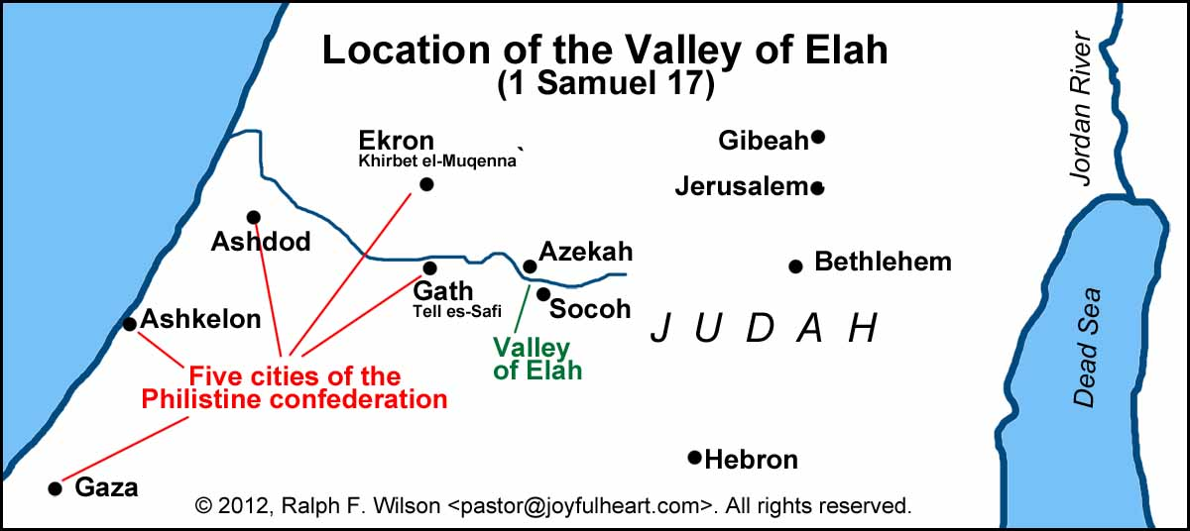
THE TERRAIN.
God’s people never have peace with the forces of darkness.
You will do battle or be defeated!

Slide 9
THE TERROR.
Giant. Gen 6:4 “and also after that”
He’s probably an Anakim (Josh 11:21-22) Notice, it’s with the Philistines that they find refuge!

Slide 10
Joshua 11:21-22 21 And at that time came Joshua, and cut off the Anakims from the mountains, from Hebron, from Debir, from Anab, and from all the mountains of Judah, and from all the mountains of Israel: Joshua destroyed them utterly with their cities. 22 There was none of the Anakims left in the land of the children of Israel: only in Gaza, in Gath, and in Ashdod, there remained.

Slide 11
THE TERRAIN.
God’s people never have peace with the forces of darkness.
You will do battle or be defeated!

Slide 12
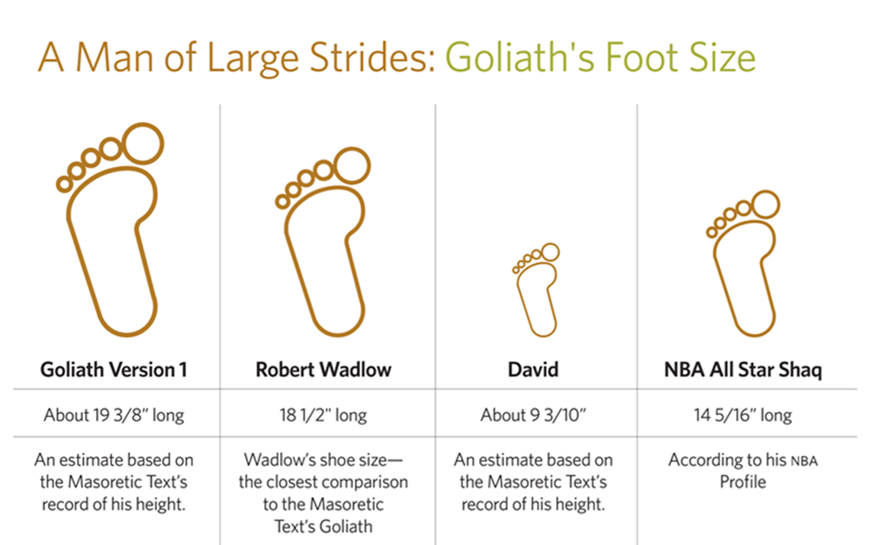

Slide 13
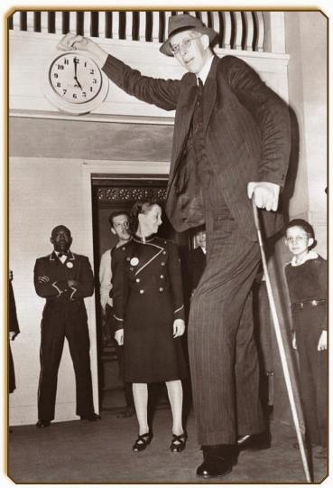
Robert Wadlow
Source of size: hyperplasia of his pituitary gland
Height – 8ft 11.1 in
Weight – 490 lbs

Slide 14
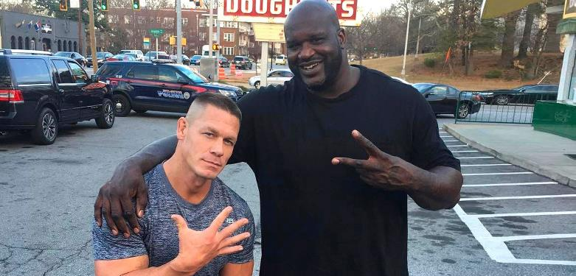

Slide 15
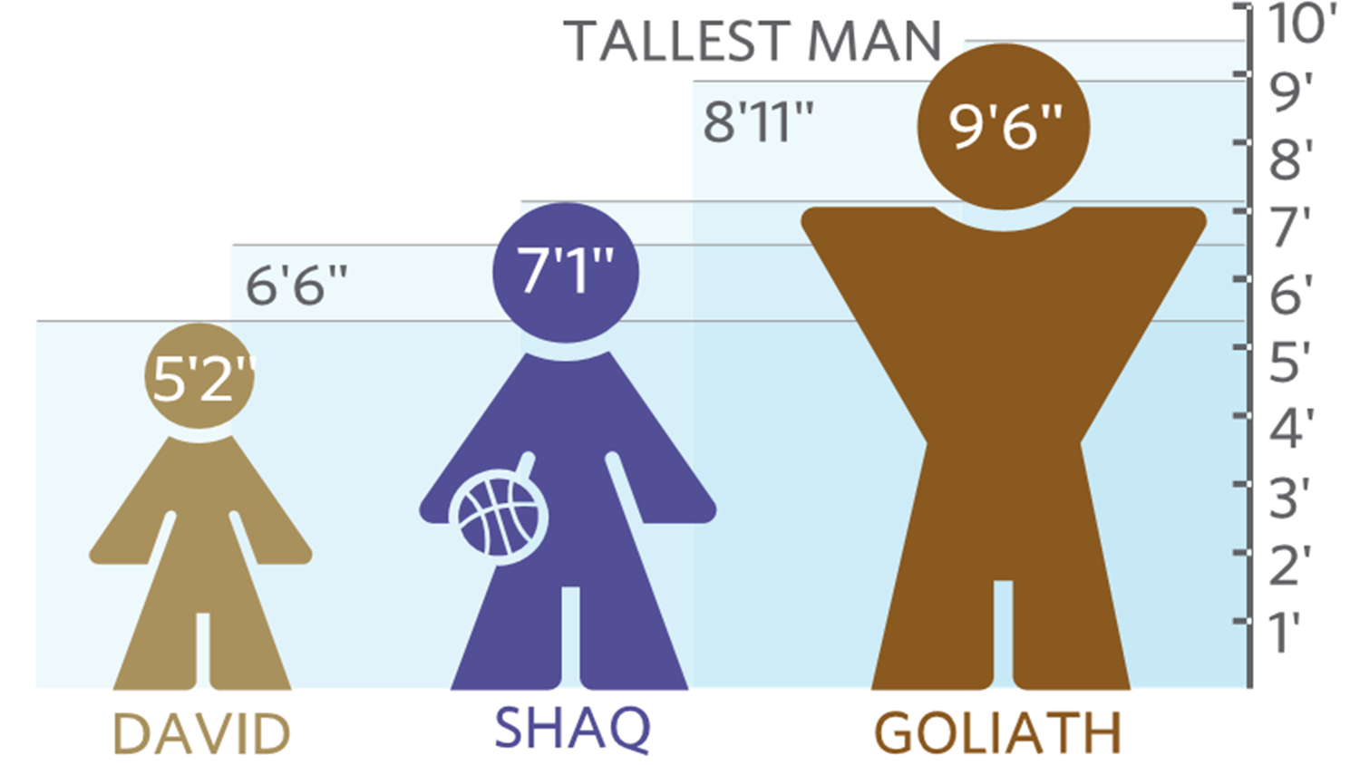

Slide 16
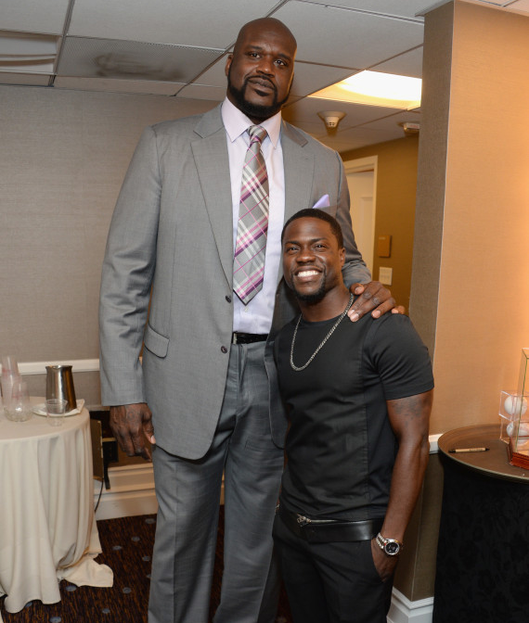

Slide 17
Job 41:15 His scales are his pride, shut up together as with a close seal.

Slide 18
Ephesians 6:13-18 13 Wherefore take unto you the whole armour of God, that ye may be able to withstand in the evil day, and having done all, to stand. 14 Stand therefore, having your loins girt about with truth, and having on the breastplate of righteousness; 15 And your feet shod with the preparation of the gospel of peace; 16 Above all, taking the shield of faith, wherewith ye shall be able to quench all the fiery darts of the wicked. 17 And take the helmet of salvation, and the sword of the Spirit, which is the word of God: 18 Praying always with all prayer and supplication in the Spirit, and watching thereunto with all perseverance and supplication for all saints;

Slide 19
THE TERROR.
Giant. Gen 6:4 “and also after that”
His numbers are “666”
Goliath is a type of antichrist.

Slide 20
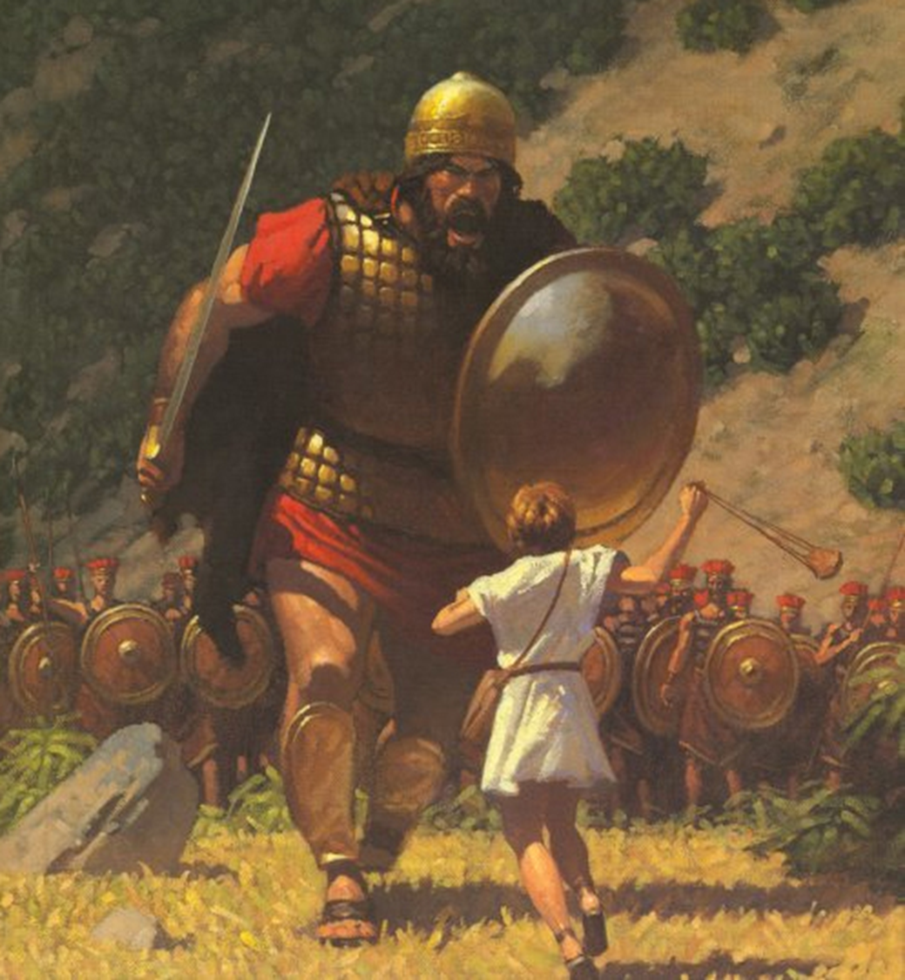

Slide 21
THE TERROR.
Giant. Gen 6:4 “and also after that”
His numbers are “666”
Goliath is a type of antichrist.
He’s defying the armies of the living God. Vs 26. This is an attack on Jehovah Himself.

Slide 22
THE TEENAGER.
David was a youth. Vs 33
When not serving as Saul’s armour bearer, he helped with his father’s flocks.
40 is the number of testing.

Slide 23
2 Timothy 1:7 For God hath not given us the spirit of fear; but of power, and of love, and of a sound mind.

Slide 24
THE TEENAGER.
David was a youth. Vs 33
When not serving as Saul’s armour bearer, he helped with his father’s flocks.
40 is the number of testing.
A type of Christ, David, shows up on the last / the 40th day.

Slide 25
THE TEENAGER.
Notice Saul’s response!
Saul wants someone to fight FOR him. He isn’t willing to go up himself. Fear
Notice David’s faith!
Notice David’s zeal!

Slide 26
Psalm 41:9 Yea, mine own familiar friend, in whom I trusted, which did eat of my bread, hath lifted up his heel against me.

Slide 27
Matthew 10:36 And a man's foes shall be they of his own household.

Slide 28
Psalm 55:12-14 12 For it was not an enemy that reproached me; then I could have borne it: neither was it he that hated me that did magnify himself against me; then I would have hid myself from him: 13 But it was thou, a man mine equal, my guide, and mine acquaintance. 14 We took sweet counsel together, and walked unto the house of God in company.

Slide 29
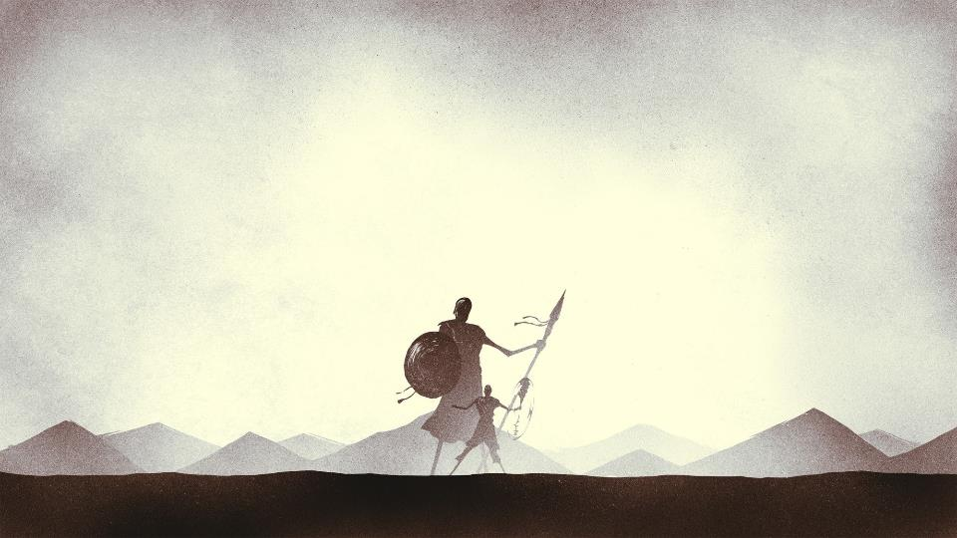
David Vs Goliath
1 Samuel 17 – Is there not a cause?

Slide 31
